Slide 1
MINI PROJECT
Group name: GOLD MEDALIST
Topic: BMI CALCULATOR
Group members:
PAVITHRA.S
PRITHIKA.Y
MADHU MITHA.S
BHARATH.V.R
HEMANATHAN.N
MOHAMMED IRFAN.S

Slide 2
BMI (Body Mass Index)
The body mass index (BMI) is a measure that uses your height and weight to work out if your weight is healthy.
The BMI calculation divides an adult's weight in kilograms by their height in metres squared. For example, A BMI of 25 means 25kg/m2

Slide 3
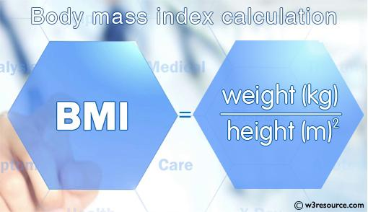
Using BMI a person can be classified into underweight, normal, overweight or obese etc according to the table below.
Formula for BMI:
BMI = kg/m2

Slide 4
Formula of BMI in Lbs:
BMI = lbs/in2
LOCATION BASED SERVICE
LBS is a software used through mobile devices accounting device's geographical location. It uses device's GPS system to locate a person's location. When a user opts in for services, service provider tracks the location of the user itself without any manual entry. It has a number of uses in social networking sites. LBS have a variety of use such as entertainment, education, personal life, etc. For example, a person can enquire about the nearest hospital from the respectiv

Slide 5
Simple Java Program to Calculate BMI of an Individual: Advance Java Program to Calculate BMI of an Individual and print if the individual is underweight, normal, overweight or obese according to following BMI categories Less than 15 = Very severely underweight bmi >= 15 but bmi < 16 = Severely underweight bmi >= 16 but bmi < 18.5 = Underweight bmi >= 18.5 but bmi < 25 = Normal (healthy weight) bmi >= 25 but bmi < 30 = Overweight bmi >= 30 but bmi < 35 = Moderately obese bmi >= 35 but bmi < 40 = Severely obese bmi > 40 = Very severely obese

Slide 6
BMI RANGES
For most adults, an ideal BMI is in the 18.5 to 24.9 range
For children and young people aged 2 to 18, the BMI calculation takes into account age and gender as well as height and weight.
If your BMI is:
below 18.5 – you're in the underweight range between 18.5 and 24.9 – you're in the healthy weight range
2. between 25 and 29.9 – you're in the overweight range
3. between30 and 39.9 – you're in the obese range

Slide 7
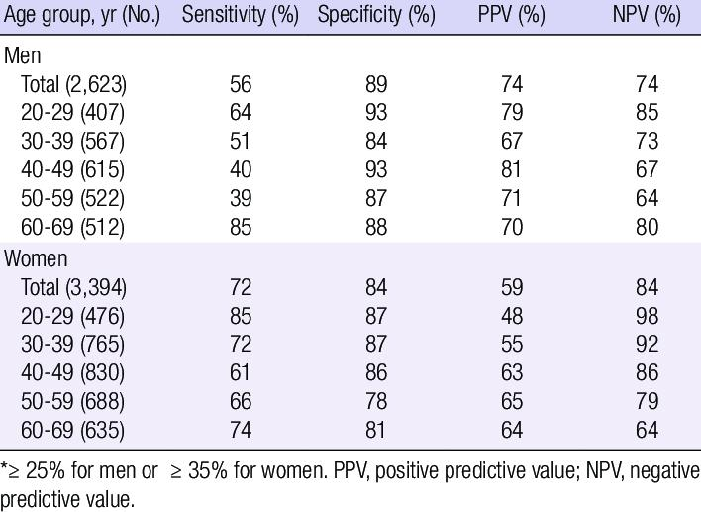
Accuracy of BMI
BMI takes into account natural variations in body shape, giving a healthy weight range for a particular height. As well as measuring your BMI, healthcare professionals may take other factors into account when assessing if you’re a healthy weight.

Slide 8
Muscle is much denser than fat, so very muscular people, such as heavyweight boxers, weight trainers and athletes, may be a healthy weight even though their BMI is classed as obese. Your ethnic group can also affect your risk of some health conditions. For example, adults of South Asian origin may have a higher risk of some health problems, such as diabetes, with a BMI of 23, which is usually considered healthy.

Slide 9
Thank you

